Slide 1
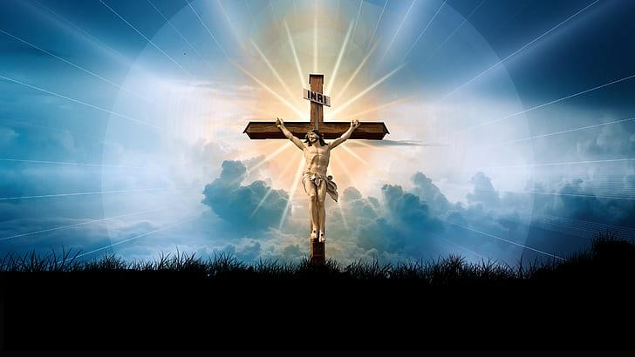
复明的人要学习见证
A Man Healed of Blindness Must Learn to Testify
约 John 9：24-34

Slide 2
📜
John 1:4 “In him was life, and the life was the light of men.”
生命在他裡頭，這生命就是人的光。（約翰福音1:4）

Slide 3
📜John 3:3 Jesus answered him, “Truly, truly, I say to you, unless one is born again he cannot see the kingdom of God.”
耶穌回答說：「我實實在在地告訴你，人若不重生，就不能見神的國。」（約翰福音3:3）
Ephesians 4:18 “They are darkened in their understanding, alienated from the life of God because of the ignorance that is in them, due to their hardness of heart.”
他們心地昏昧，與神所賜的生命隔絕了，都因自己無知，心裡剛硬。（以弗所書4:18）
Ephesians 2:3 “among whom we all once lived in the passions of our flesh, carrying out the desires of the flesh and the mind, and were by nature children of wrath, like the rest of mankind.”
我們從前也都在他們中間，放縱肉體的私慾，隨著肉體和心中所喜好的去行，本為可怒之子，和別人一樣。（以弗所書2:3）

Slide 4
✝️ 约 John 9: 24-34
John 9:24 So for the second time they called the man who had been blind and said to him, “Give glory to God. We know that this man is a sinner.”
法利賽人第二次叫了那從前瞎眼的人來，對他說：「你該將榮耀歸給神，我們知道這人是個罪人。」（約翰福音9:24）
John 9:25 He answered, “Whether he is a sinner I do not know. One thing I do know, that though I was blind, now I see.”
他回答說：「他是不是個罪人，我不知道；有一件事我知道，從前我是瞎眼的，如今能看見了。」（約翰福音9:25）

Slide 5
📜
John 9:26 They said to him, “What did he do to you? How did he open your eyes?”
他們就問他說：「他向你作了甚麼？是怎麼開了你的眼睛呢？」（約翰福音9:26）

Slide 6
📜
Philippians 2:21 For they all seek their own interests, not those of Jesus Christ.
別人都求自己的事，並不求耶穌基督的事。（腓立比書2:21）
Matthew 6:33 But seek first the kingdom of God and his righteousness, and all these things will be added to you.
你們要先求他的國和他的義，這些東西都要加給你們了。（馬太福音6:33）

Slide 7
📜
John 9:27 He answered them, “I have told you already, and you would not listen. Why do you want to hear it again? Do you also want to become his disciples?”
他回答說：「我方才告訴你們，你們不聽，為甚麼又要聽呢？莫非你們也要作他的門徒嗎？」（約翰福音9:27）

Slide 8
📜
Acts 4:13 Now when they saw the boldness of Peter and John, and perceived that they were uneducated, common men, they were astonished. And they recognized that they had been with Jesus.
他們見彼得、約翰的膽量，又看出他們原是沒有學問的小民，就希奇，認明他們是跟過耶穌的。（使徒行傳4:13）

Slide 9
John 9:28-29 And they reviled him, saying, “You are his disciple, but we are disciples of Moses. We know that God has spoken to Moses, but as for this man, we do not know where he comes from.”
他們就罵他說：「你是他的門徒，我們是摩西的門徒。神對摩西說話是我們知道的，只是這個人，我們不知道他從哪裡來。」（約翰福音9:28-29）

Slide 10
📜
John 9:30-33 The man answered, “Why, this is an amazing thing! You do not know where he comes from, and yet he opened my eyes.
We know that God does not listen to sinners, but if anyone is a worshiper of God and does his will, God listens to him.
Never since the world began has it been heard that anyone opened the eyes of a man born blind.
If this man were not from God, he could do nothing.”
那人回答說：「他開了我的眼睛，你們竟不知道他從哪裡來，這真是奇怪。
我們知道神不聽罪人，惟有敬奉神、遵行他旨意的，神才聽他。
從創世以來，未曾聽見有人把生來是瞎子的眼睛開了。
這人若不是從神來的，甚麼也不能作。」（約翰福音9:30-33）

Slide 11
📜
Lamentations 4:13 This was for the sins of her prophets and the iniquities of her priests, who shed in the midst of her the blood of the righteous.
這都因她先知的罪惡和祭司的罪孽；他們在城中流了義人的血。（耶利米哀歌4:13）

Slide 12
📜Acts 18:24-28 Now a Jew named Apollos, a native of Alexandria, came to Ephesus.
And being fervent in spirit, he spoke and taught accurately the things concerning Jesus, though he knew only the baptism of John.
He began to speak boldly in the synagogue, but when Priscilla and Aquila heard him, they took him aside and explained to him the way of God more accurately.
有一個猶太人，名叫亞波羅，來到以弗所。
這人已經在主的道上受了教訓，心裡火熱，將耶穌的事詳細講論教訓人，只是他單曉得約翰的洗禮。
他在會堂裡放膽講道；百基拉、亞居拉聽見，就接他來，將神的道給他講解更加詳細。（使徒行傳18:24-28）

Slide 13
📜
John 9:34 They answered him, “You were born in utter sin, and would you teach us?” And they cast him out.
他們回答說：「你全然生在罪孽中，還要教訓我們嗎？」於是把他趕出去了。（約翰福音9:34）

