Slide 1

2026年2月15日
新春主日证道

Slide 2


除旧迎 新
Leave the Old Behind
& Welcome the New
This Photo by Unknown Author is licensed under CC BY-SA

Slide 3
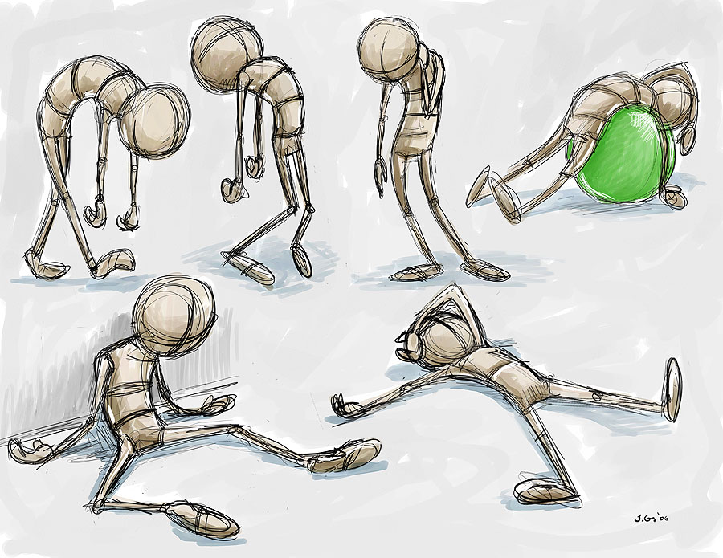

旧—Old Self
旧，真的“除”得掉吗？
Can you get the Old OFF?
旧人,不单指外面有的坏习惯
It’s not just the bad habits we see.
而主要指他里面的“无能为力”
It’s the BROKEN unseen inside you.

Slide 4

好消息-
耶稣
The Good News
JESUS

Slide 5

✝️
Romans 6:6
“ We know that our old self was crucified with him in order that the body of sin might be brought to nothing, so that we would no longer be enslaved to sin.”
罗马书 6:6 “因为知道我们的旧人和他同钉十字架，使罪身灭绝，叫我们不再作罪的奴仆；”

Slide 6

📜
Romans 6:4
“We were buried therefore with him by baptism into death, in order that, just as Christ was raised from the dead by the glory of the Father, we too might walk in newness of life.
罗马书 6:4, “ 所以，我们藉著洗礼归入死，和他一同埋葬，原是叫我们一举一动有新生的样式，像基督藉著父的荣耀从死里复活一样。”

Slide 7

2 Cor 5:17, “ Therefore, if anyone is in Christ, he is a new creation. The old has passed away; behold, the new has come.”
哥林多后书5：17，“ 若有人在基督里，他就是新造的人，旧事已过，都变成新的了。”

Slide 8

Let’s pray!
请一同祷告！
新朋友也请留步用餐交流!
New friends, welcome to stay with us for lunch and talk!

