Slide 1
有个人名叫耶稣
约9:1-12

Slide 2
✝️ 约 John 9: 1-12
1 As he passed by, he saw a man blind from birth.
1 耶稣过去的时候，看见一个人生来是瞎眼的。
2 And his disciples asked him, “Rabbi, who sinned, this man or his parents, that he was born blind?”
2 门徒问耶稣说：「拉比，这人生来是瞎眼的，是谁犯了罪？是这人呢？是他父母呢？」
3 Jesus answered, “It was not that this man sinned, or his parents, but that the works of God might be displayed in him.
3 耶稣回答说：「也不是这人犯了罪，也不是他父母犯了罪，是要在他身上显出神的作为来。

Slide 3
📜
4 We must work the works of him who sent me while it is day; night is coming, when no one can work.
4 趁著白日，我们必须作那差我来者的工；黑夜将到，就没有人能做工了。
5 As long as I am in the world, I am the light of the world.”
5 我在世上的时候，是世上的光。」
6 Having said these things, he spit on the ground and made mud with the saliva. Then he anointed the man's eyes with the mud
6 耶稣说了这话，就吐唾沫在地上，用唾沫和泥抹在瞎子的眼睛上，

Slide 4
7 and said to him, “Go, wash in the pool of Siloam” (which means Sent). So he went and washed and came back seeing.
7 对他说：「你往西罗亚池子里去洗（西罗亚翻出来就是奉差遣）。他去一洗，回头就看见了。
8 The neighbors and those who had seen him before as a beggar were saying, “Is this not the man who used to sit and beg?”
8 他的邻舍和那素常见他是讨饭的，就说：「这不是那从前坐著讨饭的人吗？」
9 Some said, “It is he.” Others said, “No, but he is like him.” He kept saying, “I am the man.”
9 有人说：是他；又有人说；不是，却是像他。他自己说：是我

Slide 5
📜
10 So they said to him, “Then how were your eyes opened?”
10 他们对他说：「你的眼睛是怎麽开的呢？」
11 He answered, “The man called Jesus made mud and anointed my eyes and said to me, ‘Go to Siloam and wash.’ So I went and washed and received my sight.”
11 他回答说：「有一个人，名叫耶稣，他和泥抹我的眼睛，对我说：『你往西罗亚池子去洗。』我去一洗，就看见了。」
12 They said to him, “Where is he?” He said, “I do not know.”
12 他们说：「那个人在那里？」他说：「我不知道。」

Slide 6
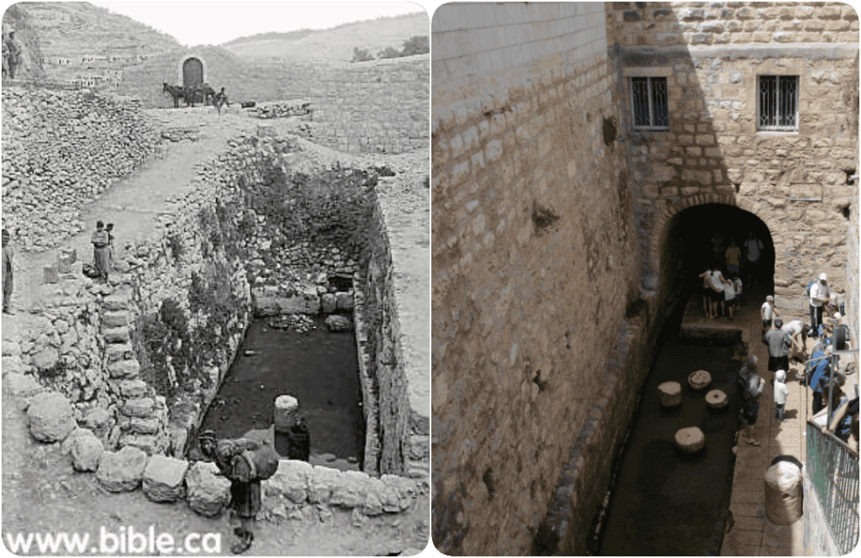
西罗亚池子 Pool of Siloam

Slide 7
📜
John 8:12 Again Jesus spoke to them, saying, “I am the light of the world. Whoever follows me will not walk in darkness, but will have the light of life.”
约 8：12 耶稣又对众人说：「我是世界的光。跟从我的，就不在黑暗里走，必要得著生命的光。」

Slide 8
📜 治愈瞎子是上帝、弥赛亚才能做的事。
Isaiah 35:5 Then the eyes of the blind shall be opened, and the ears of the deaf unstopped; 赛 35：5 那时，瞎子的眼必睁开；聋子的耳必开通。
Isaiah 42:7 to open the eyes that are blind, to bring out the prisoners from the dungeon, from the prison those who sit in darkness. 赛 42：7 开瞎子的眼，领被囚的出牢狱，领坐黑暗的出监牢。
Ps 146:8 the LORD opens the eyes of the blind. The LORD lifts up those who are bowed down; the LORD loves the righteous. 诗146：8 耶和华开了瞎子的眼睛；耶和华扶起被压下的人。耶和华喜爱义人。

Slide 9
📜
耶利米书1:5 我未将你造在腹中、我已晓得你。
Jeremiah 1:5 Before I formed you in the womb I knew you。

Slide 10
📜
Exd 20: 5 You shall not bow down to them or serve them, for I the LORD your God am a jealous God, visiting the iniquity of the fathers on the children to the third and fourth generation of those who hate me,
出 20：5 不可跪拜那些像，也不可事奉他，因为我耶和华你的神是忌邪的神。恨我的，我必追讨他的罪，自父及子，直到三四代；

Slide 11
📜
Jeremiah 29:11 For I know the plans I have for you, declares the LORD, plans for welfare and not for evil, to give you a future and a hope.
耶 29：11 耶和华说：我知道我向你们所怀的意念是赐平安的意念，不是降灾祸的意念，要叫你们末後有指望。

Slide 12
🌄
2 Cor 12: 7 So to keep me from becoming conceited because of the surpassing greatness of the revelations, a thorn was given me in the flesh, a messenger of Satan to harass me, to keep me from becoming conceited.
林后 12：7 又恐怕我因所得的启示甚大，就过於自高，所以有一根刺加在我肉体上，就是撒但的差役要攻击我，免得我过於自高。

Slide 13
☀️
Genesis 50:20 As for you, you meant evil against me, but God meant it for good, to bring it about that many people should be kept alive, as they are today.
创 50：20 从前你们的意思是要害我，但神的意思原是好的，要保全许多人的性命，成就今日的光景。
1 Thess 5:5 For you are all children of light, children of the day. We are not of the night or of the darkness.
贴前 5：5 你们都是光明之子，都是白昼之子。我们不是属黑夜的，也不是属幽暗的。

Slide 14
🌱不只一种方法 More than one method to heal the blind
1 不触摸，只凭话语。
马可福音 10:46–52巴底买
2 触摸眼睛医治
马太福音 9:29 两个瞎子
3 触摸 + 唾沫
马可福音 8:22–25（伯赛大，分阶段医治，耶稣不受立即见效模式限制）
4 和泥（唾沫 + 泥土）＋去洗
约翰福音 9:6–7（生来瞎眼的人）
1 Without touching, by word alone Mark 10:46–52 — Bartimaeus
2 Healing by touching the eyes
Matthew 9:29 — the two blind men
3 Touching + saliva
Mark 8:22–25 (Bethsaida; a two-stage healing, showing that Jesus is not bound to an “instant result” pattern)
4 Making mud (saliva + dirt) and sending him to wash
John 9:6–7 (the man born blind)

Slide 15
☀️
Heb 3:15 As it is said, “Today, if you hear his voice, do not harden your hearts as in the rebellion.”
来 3：15 经上说：「你们今日若听他的话，就不可硬著心，像惹他发怒的日子一样。」
James 1:25 But the one who looks into the perfect law, the law of liberty, and perseveres, being no hearer who forgets but a doer who acts, he will be blessed in his doing.
雅各1：25 惟有详细察看那全备，使人自由之律法的，并且时常如此，这人既不是听了就忘，乃是实在行出来，就在他所行的事上必然得福。

