Slide 1

🌟不要死在自己的罪里 🌟
Don’t Die in Your Sin
约翰福音John 8:21-30

Slide 2
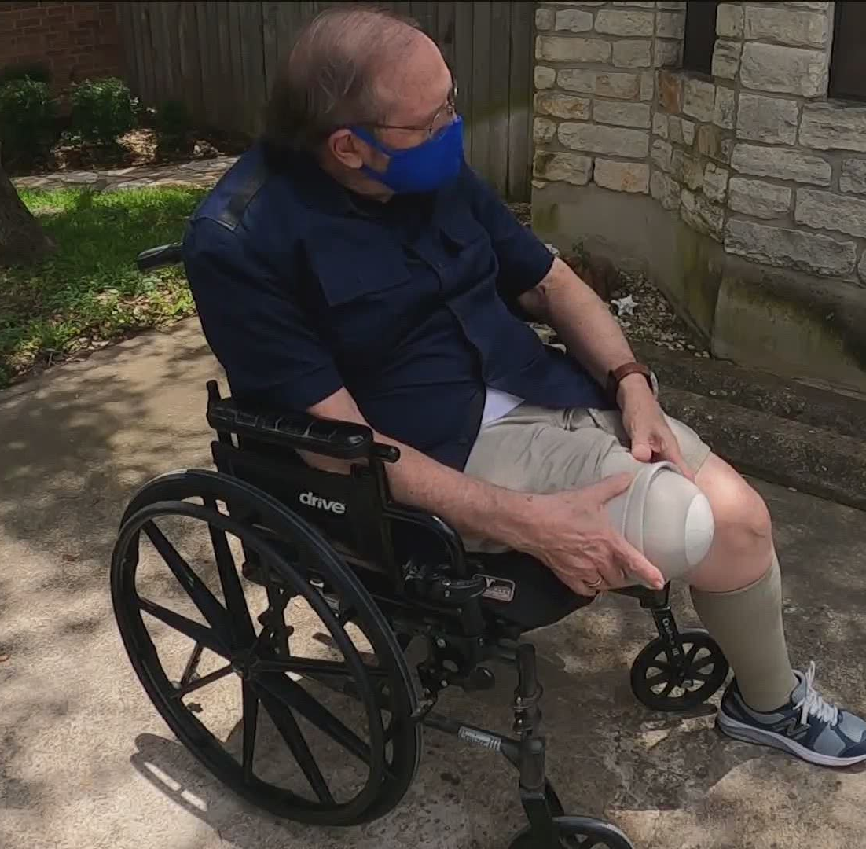
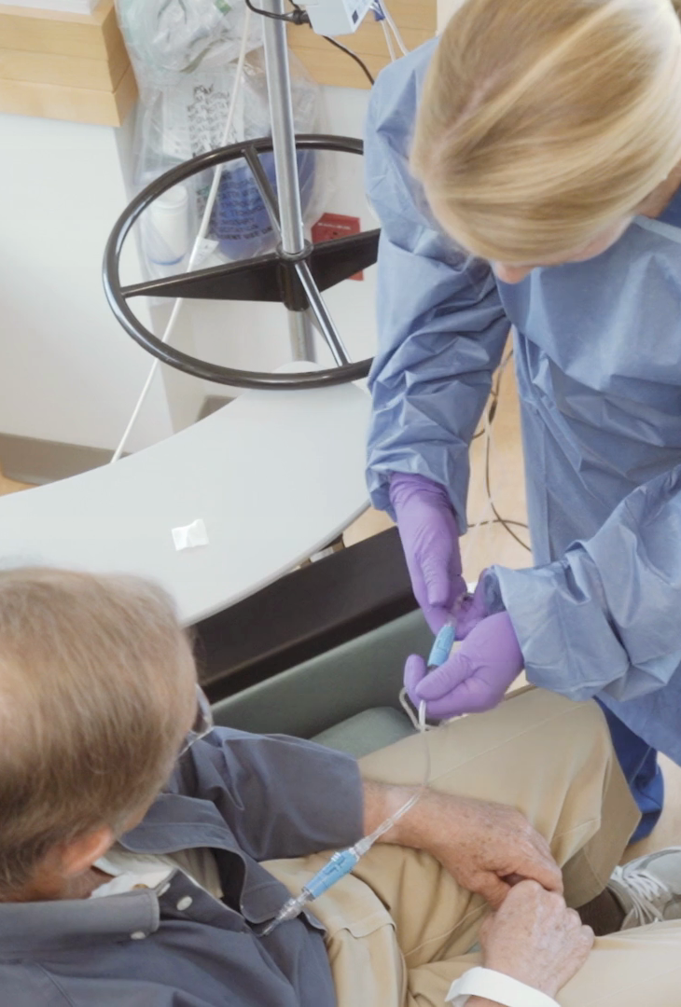
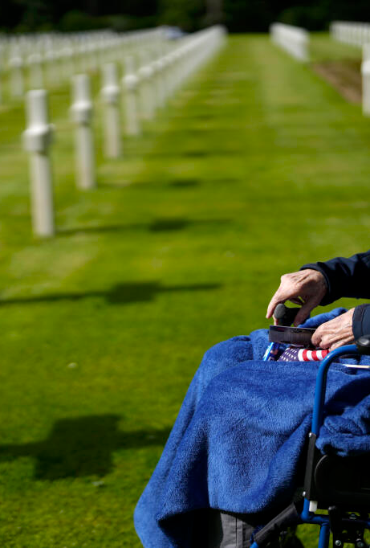
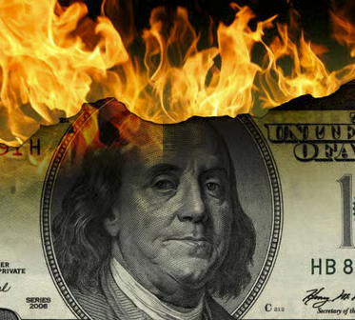

Slide 3
✝️
其中您认为最糟糕的事情是什么？Which one is the worst?
是配偶、孩子或朋友的死亡？Death of spouse, children, or friends?
是医生告诉您患了癌症？Doctor said you got cancer?
是失去所有财产？You lost all your ownings?
或是其它？Or anything else?

Slide 4
📜约John 8:21-30
约8:21 耶稣又对他们说：“我要去了，您们要寻找我，并且要在自己的罪中死亡；我去的地方，您们不能到。”
Then he said to them again, I am going away and you will be looking for me, but death will overtake you in your sins. It is not possible for you to come where I am going.
约8:22 于是犹太人说：“他说‘我去的地方，您们不能到’，难道他要自杀吗？”
So the Jews said, Will he take his life? Is that why he says, Where I go it is not possible for you to come?

Slide 5
📜
约8:23 耶稣说：“您们是从地上来的，我是从天上来的；您们属这世界，我却不属这世界，
And he said to them, You are of the earth; I am from heaven: you are of this world; I am not of this world.
约8:24 所以我对您们说，您们要在自己的罪中死亡；您们若不信我就是‘那一位’，就要在自己的罪中死亡。”
For this reason I said to you that death will overtake you in your sins: for if you have not faith that I am he, death will come to you while you are in your sins.

Slide 6
📜
约8:25 他们就问：“您是谁？”耶稣说：“我不是从起初就告诉您们吗？
Then they said to him, Who are you? Jesus said, What I said to you from the first.
约8:26 关于您们，我有许多事要说，要判断；但那差我来的是真实的，我从他那里听见的，就告诉世人。”
I have much to say about you and against you: but he who sent me is true and what he has said to me I say to the world.
约8:27 他们不明白耶稣是对他们讲论父的事。
They did not see that his words were about the Father.

Slide 7
📜约8:28 所以耶稣说：“您们举起了人子以后，必定知道我就是‘那一位’，并且知道我不凭着自己作什么事；我说的这些话，是照着父所教导我的。
So Jesus said, When the Son of man has been lifted up by you, then it will be clear to you who I am, and that I do nothing of myself, but say as the Father gave me teaching.
约8:29 那差我来的和我同在，他没有留下我独自一人，因为我常作他喜悦的事。”
He who sent me is with me; he has not gone from me, because at all times I do the things which are pleasing to him.
约8:30 耶稣说这些话的时候，就有许多人信了他。
When he said this a number came to have faith in him.

Slide 8
📜基督是谁？Who is Christ?
太 Matt 16:15-17 他问他们：“您们说我是谁？”He says to them, But who do you say that I am?
太16:16 西门．彼得回答：“您是基督，是永生神的儿子。”And Simon Peter made answer and said, You are the Christ, the Son of the living God.
太16:17 耶稣对他说：“约拿的儿子西门，您是有福的，因为这不是人指示您的，而是我在天上的父启示您的。
And Jesus made answer and said to him, A blessing on you, Simon Bar-jonah: because this knowledge has not come to you from flesh and blood, but from my Father in heaven.

Slide 9
📜钉十字架 - 1 应验旧约预言 Crucifixion - Fulfillment of Old Testament Prophecies
以赛亚书53:5–7：受苦的仆人“为我们的罪被刺透”，“如羊羔被牵去宰杀”。
Isaiah 53:5–7: The Suffering Servant is “pierced for our transgressions” and “led like a lamb to the slaughter.”
诗篇22:16–18：描述手脚被刺、分衣抽签，在十字架上应验（约翰福音19:23–24）。
Psalm 22:16–18: Describes piercing of hands and feet and casting lots for clothing, both fulfilled at the crucifixion (John 19:23–24).

Slide 10
🪔 2 十字架上的超自然神迹：大黑暗、地震、幔子裂开、圣徒复活 Supernatural Miracles at the Cross: great darkness, earthquake, temple curtain split, resurrection of saints.
摩 Amos 8:9
“到那日，这是耶和华的宣告：我必使太阳在正午落下，在白昼使地变成昏暗。And it will come about in that day, says the Lord God, that I will make the sun go down in the middle of the day, and I will make the earth dark in daylight
外邦人如罗马百夫长，宣称：“这人真是神的儿子！” Roman centurion, to proclaim, “Truly this man was the Son of God!”（马可福音Mark 15:39）

Slide 11
🎉3 耶稣在十字架上的行为展现了弥赛亚的特质 Jesus’ Actions on the Cross Showed Messianic Qualities
宽恕 Forgiveness：他赦免执行者的罪 He forgave those who crucified Him （路加福音 Luke 23:34）。
对强盗的应许Promise to the thief ：他向悔改的强盗保证天堂 He assured the repentant thief of paradise （路加福音 Luke 23:43）。
胜利的宣告Victorious declaration：“成了 It is finished”（约翰福音 John19:30）。

Slide 12
🌄4复活与事后确认 Resurrection and Post-Crucifixion Confirmation：
空坟墓和显现 The empty tomb and appearances （约翰福音 John 20–21，使徒行传 Acts 1:3）
门徒在圣灵充满下宣扬耶稣为弥赛亚 The disciples, filled with the Holy Spirit, proclaimed Jesus as the Messiah （使徒行传 Acts 2:32–36）。
起初拒绝的犹太领袖重新思考，许多人信服 Jewish leaders who initially rejected Jesus reconsidered and believed（使徒行传Acts 4:1–4）。

Slide 13
🔥地狱之可怕 The horror of hell
可Mark 9:43 如果您的一只手使您犯罪，就把它砍下来。您身体残废进永生，总比有两只手下到地狱，进入那不灭的火里好得多。
And if your hand is a cause of trouble to you, let it be cut off; it is better for you to go into life with one hand than to have two hands and go into hell, into the eternal fire.
可Mark9:45
如果您的一只脚使您犯罪，就把它砍下来。您瘸腿进永生，总比您有两只脚而被丢在地狱里好得多。And if your foot is a cause of trouble to you, let it be cut off: it is better for you to go into life with one foot than to have two feet and go into hell.

Slide 14
🔥 地狱之可怕 The horror of hell
可Mark9:47 如果您的一只眼睛使您犯罪，就把它挖出来。您只有一只眼睛进 神的国，总比您有两只眼睛而被丢在地狱里好得多，
And if your eye is a cause of trouble to you, take it out: it is better for you to go into the kingdom of God with one eye than, having two eyes, to go into hell,
可Mark9:48
在那里虫是不死的，火是不灭的。
Where their worm is ever living and the fire is not put out.

Slide 15
应得的刑罚 与 神的恩典 🌱Punishment deserved and God’s grace
罗Rom 5:8
唯有基督在我们还作罪人的时候为我们死， 神对我们的爱就在此显明了。But God has made clear his love to us, in that, when we were still sinners, Christ gave his life for us.
以弗所书Eph 2:5
就在我们因过犯死了的时候，使我们与基督一同活过来，（您们得救是靠着恩典，）
Even when we were dead through our sins, gave us life together with Christ (by grace you have salvation)

Slide 16
☀️
约8:23耶稣说：“您们是从地上来的，我是从天上来的；您们属这世界，我却不属这世界
And he said to them, You are of the earth; I am from heaven: you are of this world; I am not of this world.
赛Isa 55:11
从我的口所出的话也必这样，必不徒然返回我这里，却要作成我所喜悦的，使它在我差遣它去作的事上必然亨通。
So will my word be which goes out of my mouth: it will not come back to me with nothing done, but it will give effect to my purpose, and do that for which I have sent it.

Slide 17
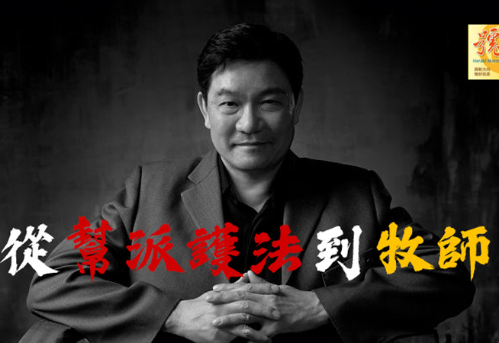
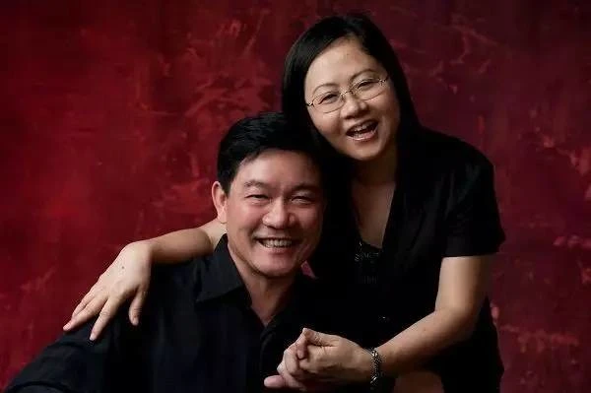
📜From being a gangster to being a pastor

Slide 18
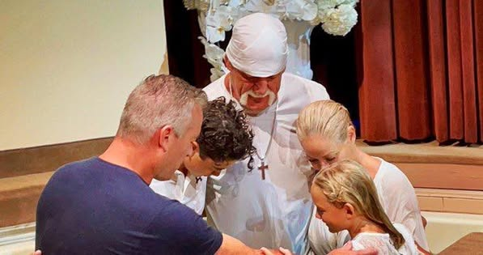
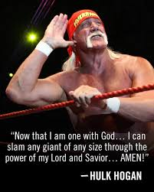
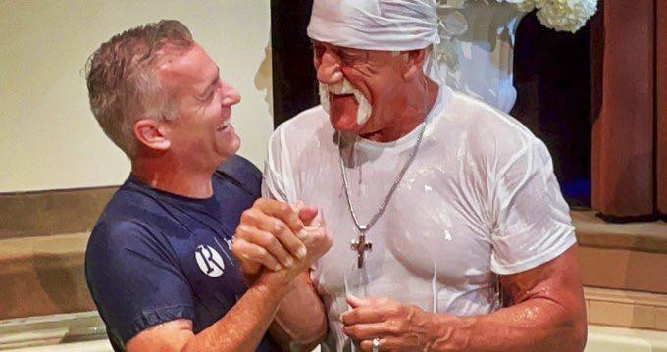
Hulk Hogan’s baptism

Slide 19
🤝⚖️
机会窗口快要关闭了
那时还没有信耶稣的，只能是死在自己的罪中, 下地狱
您呢？您的罪被赦免了吗？

