Slide 1

🌟耶稣是世界的光 🌟 Jesus is the Light of the World 约翰福音John 8:12-20

Slide 2
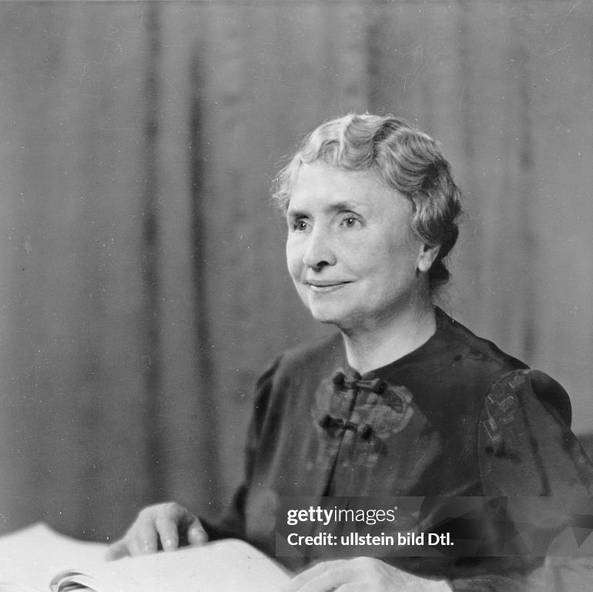
海伦凯勒 Helen Keller

Slide 3
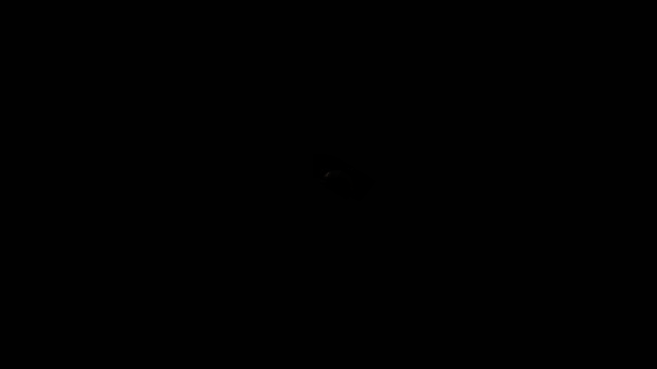

Slide 4
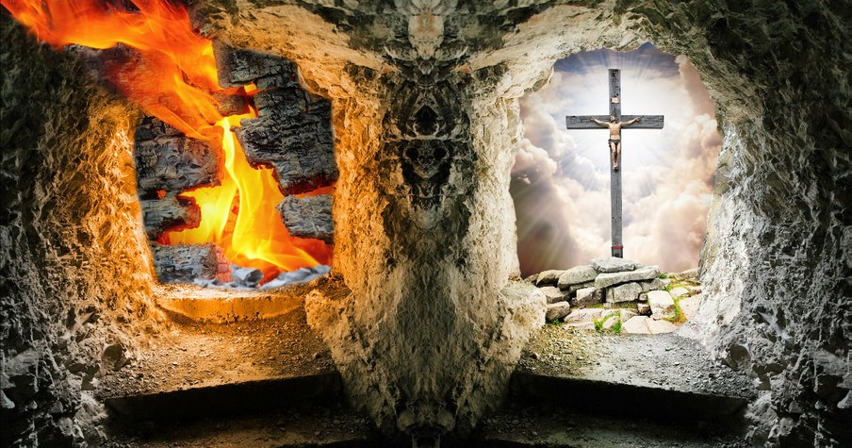

Slide 5
创Gene 1:3📜
神说：“要有光。”就有了光。
And God said, Let there be light: and there was light.
诗Ps 36:9
因为在你那里有生命的源头，在你的光中，我们必得见光。
For with thee is the fountain of life: in thy light shall we see light.

Slide 6
约8:13-14 📜
法利赛人对他说：“你是为自己作见证，你的见证不真。”
The Pharisees therefore said unto him, Thou bearest record of thyself; thy record is not true.
耶稣说：“我虽然为自己作见证，我的见证还是真的。因我知道我从哪里来，往哪里去；你们却不知道我从哪里来，往哪里去。
Jesus answered and said unto them, Though I bear record of myself, yet my record is true: for I know whence I came, and whither I go; but ye cannot tell whence I come, and whither I go.

Slide 7
约8:15-16 📜
你们是以外貌（原文作“凭肉身”）判断人，我却不判断人。
Ye judge after the flesh; I judge no man.
就是判断人，我的判断也是真的，因为不是我独自在这里，还有差我来的父与我同在。
And yet if I judge, my judgment is true: for I am not alone, but I and the Father that sent me.

Slide 8
约8:17-18 📜
你们的律法上也记着说：‘两个人的见证是真的。’
It is also written in your law, that the testimony of two men is true.
我是为自己作见证，还有差我来的父也是为我作见证。”
I am one that bear witness of myself, and the Father that sent me beareth witness of me.

Slide 9
约8:19-20 📜
他们就问他说：“你的父在哪里？”耶稣回答说：“你们不认识我，也不认识我的父；若是认识我，也就认识我的父。”
Then said they unto him, Where is thy Father? Jesus answered, Ye neither know me, nor my Father: if ye had known me, ye should have known my Father also.
这些话是耶稣在殿里的库房教训人时所说的，也没有人拿他，因为他的时候还没有到。
These words spake Jesus in the treasury, as he taught in the temple: and no man laid hands on him; for his hour was not yet come.

Slide 10
✨ 诗Ps 84:11 因为耶和华 神是日头，是盾牌，要赐下恩惠和荣耀。他未尝留下一样好处不给那些行动正直的人。
For the LORD God is a sun and shield: the LORD will give grace and glory: no good thing will he withhold from them that walk uprightly.
玛 Malachi 4:2
但向你们敬畏我名的人，必有公义的日头出现，其光线有医治之能。你们必出来跳跃如圈里的肥犊。
But unto you that fear my name shall the Sun of righteousness arise with healing in his wings; and ye shall go forth, and grow up as calves of the stall.

Slide 11
约 John 8:12 🌍
“我是世界的光”
I am the light of the world
Εγω ειμαι το φως του κοσμου⋅ （Egō eimi to phōs tou kosmou）
“我就是那世界的光 ——是独一无二的光” 🌟

Slide 12
✝️约 John 5:31-39
耶稣所列举了如下可以证明自己途径，也是法利赛人可以接触到的内容Jesus listed the following ways to testify about Himself — which were also accessible to the Pharisees：
他们可以阅读圣经They could read the Scriptures
亲眼见证神迹Personally witness miracles
听取其他人的见证（例如施洗约翰）Listen to the testimonies of others (such as John the Baptist)
另外耶稣也列举了父，作为他的见证 Additionally, Jesus also listed the Father as a witness for Him.

Slide 13
🌬️父怎么给他做见证？耶稣的神迹和他说的话
How does the Father testify about Him? Through Jesus’ miracles and the words He spoke（约翰John 10:37-38, 5:36, and 14:10-11.）
约10:38 我若行了，你们纵然不信我，也当信这些事，叫你们又知道又明白：父在我里面，我也在父里面。”But if I do, though ye believe not me, believe the works: that ye may know, and believe, that the Father is in me, and I in him.
14:10 我在父里面，父在我里面，你不信吗？我对你们所说的话，不是凭着自己说的，乃是住在我里面的父做他自己的事。
Believest thou not that I am in the Father, and the Father in me? the words that I speak unto you I speak not of myself: but the Father that dwelleth in me, he doeth the works.

Slide 14
✝️我是自有永有 I am Who I am (出 Exod 3:14)
我是生命的粮 I am the bread of life (约 John 6:35)
我是世界的光 I am the light of the world (约 John 8:12)
我是羊的门 I am the gate of sheep (约 John 10:7, 9)
我是好牧人 I am the good shepherd (约 John 10:11, 14)
我是复活和生命 I am resurrection and life (约 John 11:25)
我是道路、真理和生命 I am the path, truth, and life (约 John 14:6)
我是真葡萄树 I am the true vine (约 John 15:1, 5)

Slide 15
⚖️申Deu 16:18-20 他们必按公义的审判判断百姓。and they shall judge the people fairly.
马太福音 Matt 7:1-5 警告不可自义论断，但教导先除去自己眼中的梁木，再帮助弟兄；warns against self-righteous judgment but teaches that one should first remove the plank from their own eye before helping a brother.
约翰福音 John 7:24：不可按外貌断定是非，总要按公平断定是非。Do not judge by appearances, but judge with righteous judgment.
哥林多前书 1 Corin 5:12-13吩咐教会审判内部的罪，以保持圣洁，但需温柔恢复（加拉太书6:1）。commands the church to judge sin within itself to maintain holiness, but restoration must be done gently (Galatians 6:1)

Slide 16
约8:15 你们是以外貌（原文作“凭肉身”）判断人，我却不判断人。Ye judge after the flesh; I judge no man. 💎
🌈 kata tēn sarka (κατὰ τὴν σάρκα), translated as “by human standards 外貌、世界的标准” or “according to the flesh 肉身.“
“按肉体”（σάρξ, sarx）：“肉体”常指人类堕落的、有限的或带有罪性的本性，脱离神的引导 astray from God’s guidance。🪨
以肉体 flesh 判断意味着基于外表、世俗或人类理性的评判，缺乏神的真理 short of God’s truth or spiritual insight。 🎨
“按世界标准 human standard”：指以人类的社会规范、外观或有限知识来判断，忽视神的启示 lacks divine revelation。🎉

Slide 17
📁 2001年10月的《国家地理》杂志，标题是“光的力量”。 “Power of Light” The Oct. 2001 edition of the National Geographic：
📌“光向我们揭示这个世界。身与心都渴望光。Light reveals the world to us. Body and soul crave it.
光设定我们的生物钟，引发我们大脑对色彩的感知。Light sets our biological clocks. It triggers in our brains the sensations of color.
光滋养我们，使植物生长，为我们提供能量。Light feeds us, supplying the energy for plants to grow.
它通过彩虹和落日的特效启发我们。It inspires us with special effects like rainbows and sunsets.
光赋予我们改变世界的工具，从白炽灯泡到激光和光纤。Light gives us life - changing tools, from incandescent bulbs to lasers and fiber optics.

Slide 18
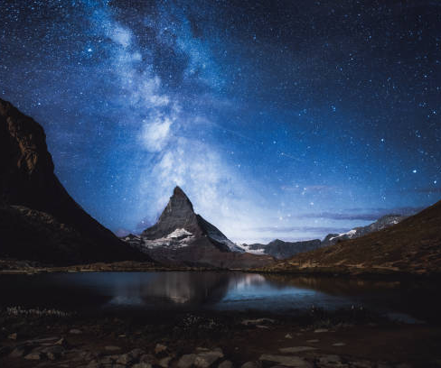
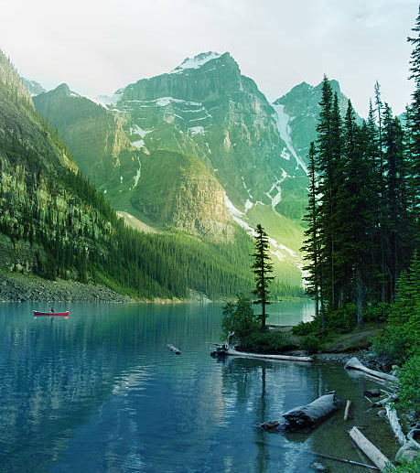
Beautiful?

Slide 19

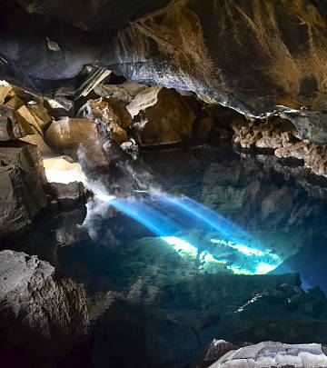
Why so beautiful?

Slide 21
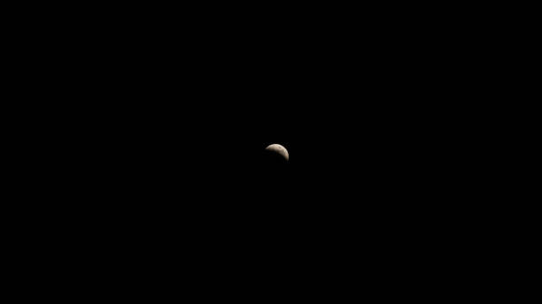

Slide 22
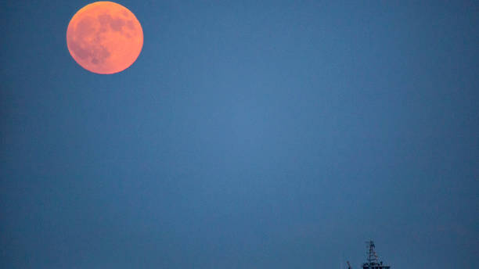

Slide 23
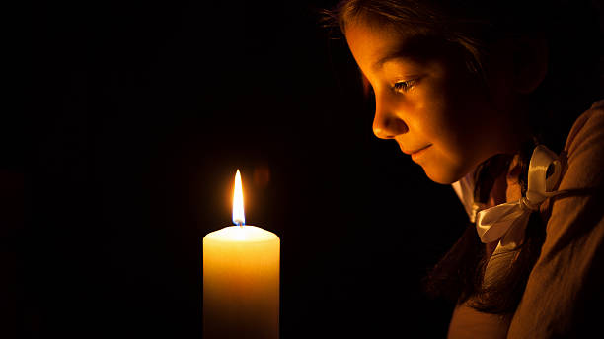

Slide 24
☀️诗篇 Ps 74:20：因为地上黑暗之处都满了强暴的居所。for the dark places of the earth are full of the habitations of cruelty.
诗 Ps 107:10 那些坐在黑暗中死荫里的人，被困苦和铁链捆锁，
Such as sit in darkness and in the shadow of death, being bound in affliction and iron
传Ecc 2:14 愚昧人在黑暗里行。but the fool walketh in darkness
传 Ecc 5:17 并且他终身在黑暗中吃喝，多有烦恼，又有病患呕气。All his days also he eateth in darkness, and he hath much sorrow and wrath with his sickness.

Slide 25
什么是我们的光 What is our light？
🌟诗篇27:1： 耶和华是我的亮光、是我的拯救．The LORD is my light and my salvation
诗篇Ps 119:105：你的话是我脚前的灯，是我路上的光。Thy word is a lamp unto my feet, and a light unto my path.

Slide 26
让我们能看见 enable us to see
🌟诗篇Ps 119:130 你的言语一解开，就发出亮光，使愚人通达。The entrance of thy words giveth light; it giveth understanding unto the simple.
撒母耳记下2 Sam 22:29耶和华啊，你是我的灯；耶和华必照明我的黑暗。For thou art my lamp, O LORD: and the LORD will lighten my darkness.

Slide 27
🌱医治滋润 heal and nourish
诗Ps 107:20 他发命医治他们，救他们脱离死亡。He sent his word, and healed them, and delivered them from their destructions.
箴言Prov 3:7-8：不要自以为有智慧；要敬畏耶和华，远离恶事。这便医治你的肚脐，滋润你的百骨。Be not wise in thine own eyes: fear the LORD, and depart from evil. It shall be health to thy navel, and marrow to thy bones.
箴言Prov 4:20–22 因为得着我的话语的，就得了生命，又得了医全体的良药。For my words are life unto those that find them, and health to all their flesh.

Slide 28
🪔喜乐 joy
约 John 15:11 这些事我已经对你们说了，是要叫我的喜乐存在你们心里，并叫你们的喜乐可以满足。These things I have spoken to you, that my joy may be in you, and that your joy may be full.
赛Isaiah 61:10我因耶和华大大欢喜，我的心靠神快乐；因他以拯救为衣给我穿上 I will greatly rejoice in the Lord; my soul shall exult in my God, for he has clothed me with the garments of salvation…”
诗篇Ps 19:8：耶和华的训词正直，能快活人的心；耶和华的命令清洁，能明亮人的眼目。The statutes of the LORD are right, rejoicing the heart: the commandment of the LORD is pure, enlightening the eyes.

Slide 29
🤝我们需要大光，不是反光、小光、微光 We need great light, not reflection, nor little light.
太Matt 4:16 那坐在黑暗里的百姓，看见了大光；The people which sat in darkness saw great light;
赛Isaiah 55:2–3 你们当就近我来，侧耳而听，就必得活 Listen diligently to me, and eat what is good... Incline your ear, and come to me; hear, that your soul may live.
歌罗西Colossians 2:3 所积蓄的一切智慧知识，都在他里面藏着。In Christ are hidden all treasures of wisdom and knowledge
约John 15:5 John 15:5 因为离了我，你们就不能做什么 Apart from Me, you can do nothing

Slide 30
🌄 世界需要光 The world needs light.
马太Matt 5:14-16
你们是世上的光。城造在山上，是不能隐藏的。Ye are the light of the world. A city that is set on an hill cannot be hid.
人点灯，不放在斗底下，是放在灯台上，就照亮一家的人。Neither do men light a candle, and put it under a bushel, but on a candlestick; and it giveth light unto all that are in the house.
你们的光也当这样照在人前，叫他们看见你们的好行为，便将荣耀归给你们在天上的父。Let your light so shine before men, that they may see your good works, and glorify your Father which is in heaven.

Slide 31
🤝那些真正跟随基督的人，也许会一时跌入黑暗中，但他们不会持续地“行在”黑暗里（约12:46；约壹1:5—2:2；诗篇36:9）。
Those who truly follow Christ may at times fall into darkness, but they will not continue to walk in darkness. (John 12:46; 1 John 1:5–2:2; Psalm 36:9)

