Slide 1
最重大的历史事件
The Most Significant Historical Events
圣诞短讲 王弟兄
A Short Message for Christmas by Bro. Wang

Slide 2
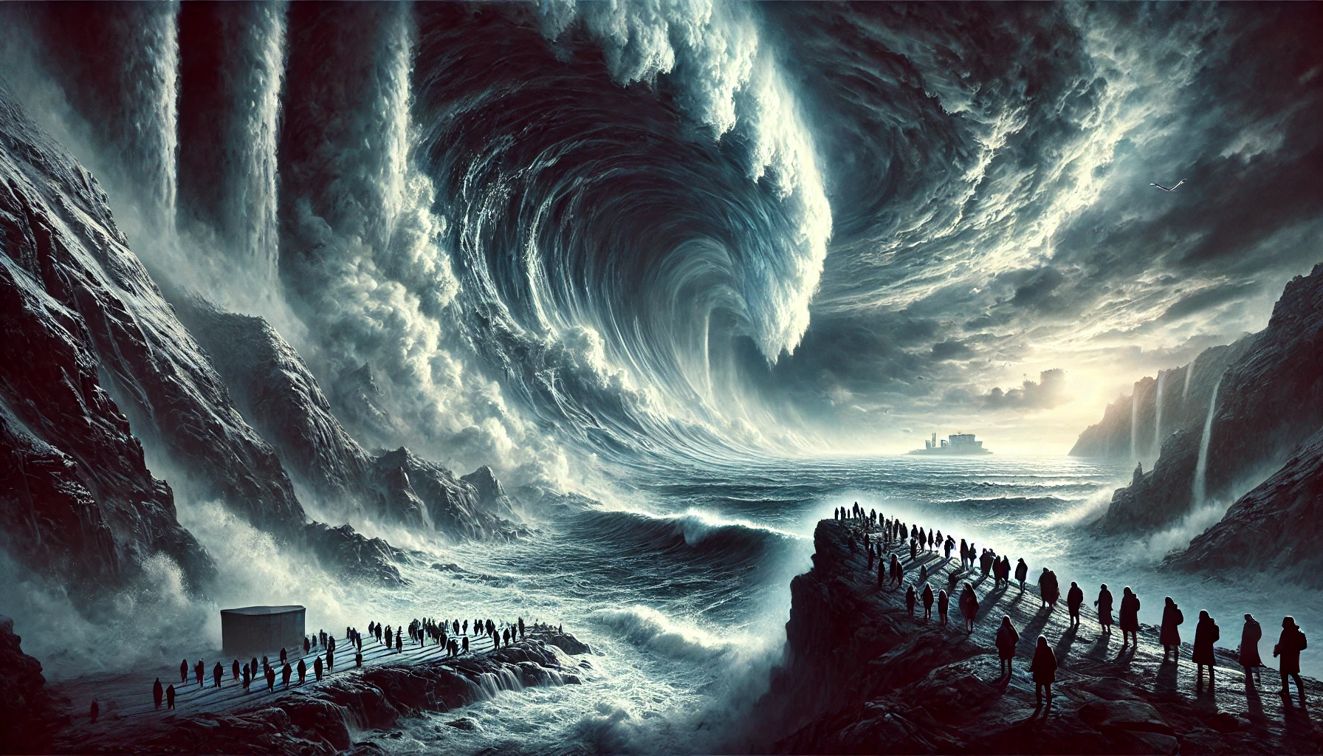
人在地球大自然面前很渺小 People humbled and powerless before the forces of nature on the earth.

Slide 3
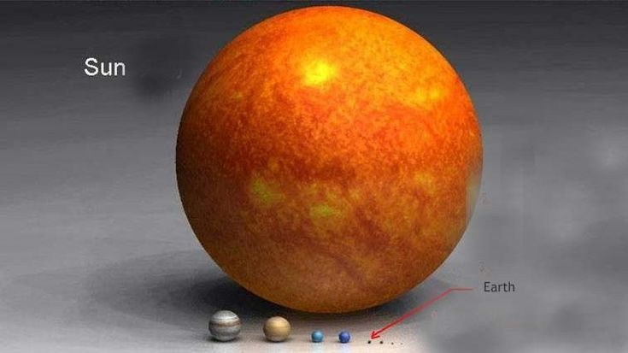
地球 Earth vs 太阳 Sun / 1 vs 130万 1.3 mil

Slide 4
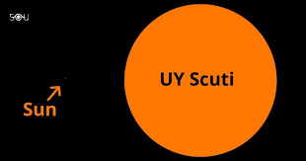
太阳 Sun vs UY Scuti / 1 vs 50亿 5 billion

Slide 5
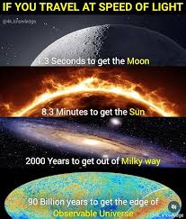
光速前进 Travel at speed of light
1.3秒 seconds 到达月亮 the Moon
8.3 分 minutes 达到太阳 the Sun
2000年 years 出银河系 Milky Way
两万亿个星系two trillion galaxies
900亿年到达宇宙的可视边缘 90billion years to get the edge of Observable Universe

Slide 6
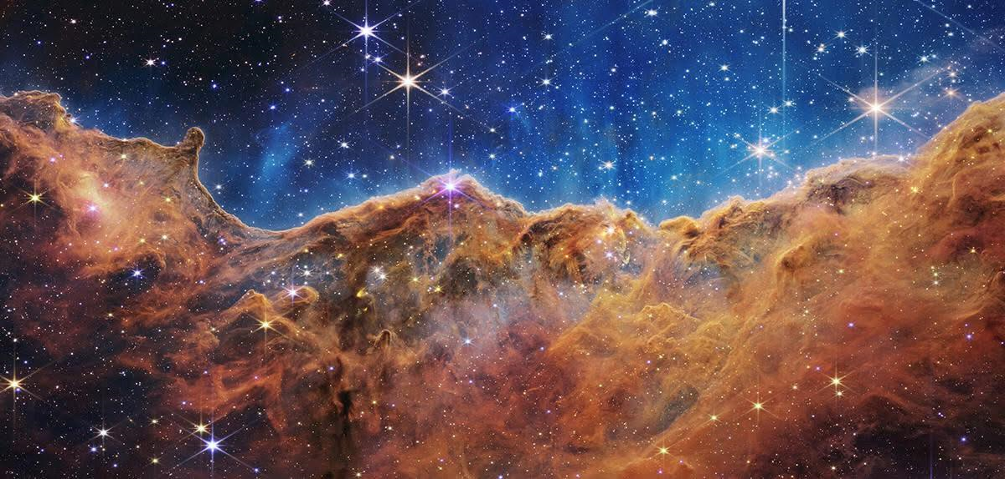
诗8:3 我观看你指头所造的天，并你所陈设的月亮星宿，
When I consider thy heavens, the work of thy fingers, the moon and the stars, which thou hast ordained;
诗8:4 便说，人算什么，你竟顾念他？世人算什么，你竟眷顾他？
What is man, that thou art mindful of him? and the son of man, that thou visitest him?
诗8:5 你叫他比天使微小一点，并赐他荣耀尊贵为冠冕。
For thou hast made him a little lower than the angels, and hast crowned him with glory and honour.

Slide 7
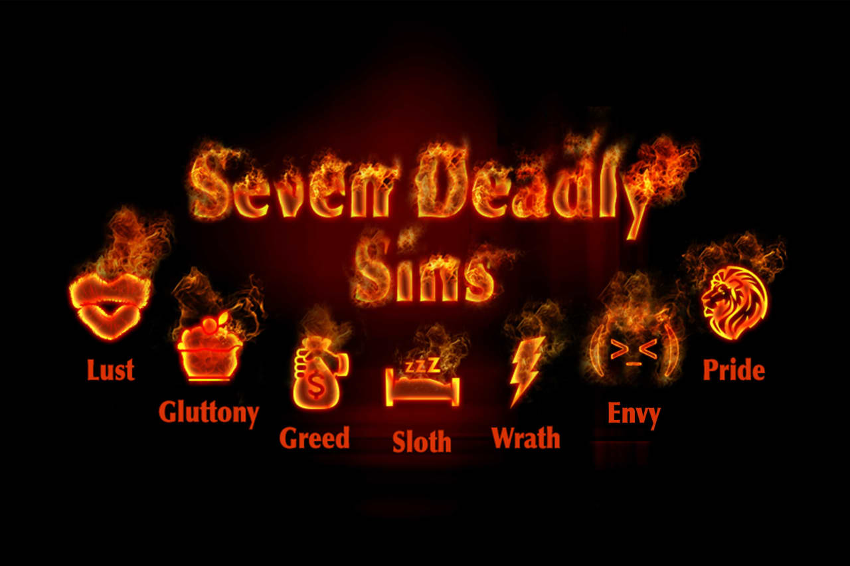
罗 Romans 3:23
因 为 世 人 都 犯 了 罪 ， 亏 缺 了 神 的 荣 耀 。
For all have done wrong and are far from the glory of God

Slide 8
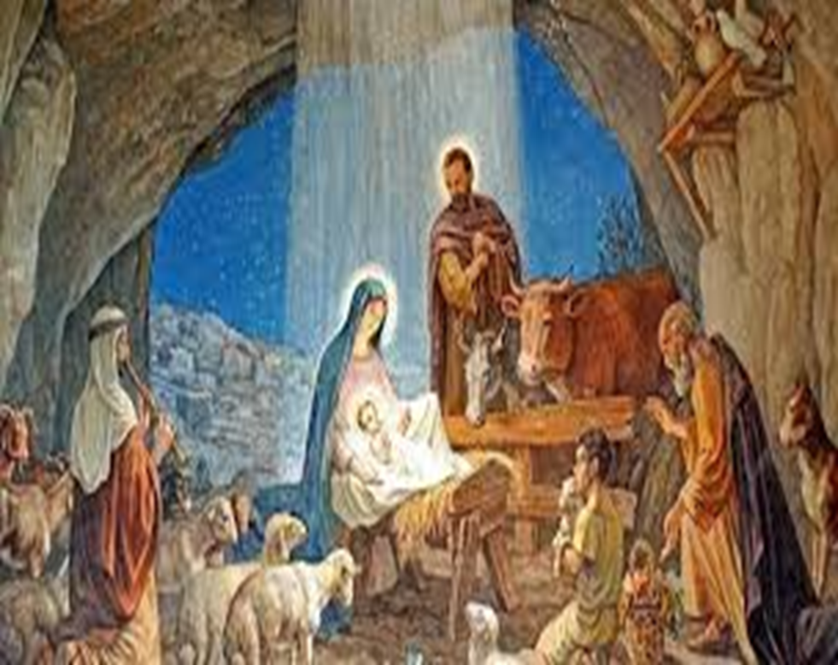
腓 Philippines 2:6-11
他本有 神的形像，不以自己与 神同等为强夺的，
Who, being in the form of God, thought it not robbery to be equal with God:
反倒虚己，取了奴仆的形像，成为人的样式。
But made himself of no reputation, and took upon him the form of a servant, and was made in the likeness of men:

Slide 9
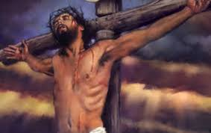
以马内利 Immanuel
既有人的样子，就自己卑微，存心顺服，以至于死，且死在十字架上。
And being found in fashion as a man, he humbled himself, and became obedient unto death, even the death of the cross.

Slide 10
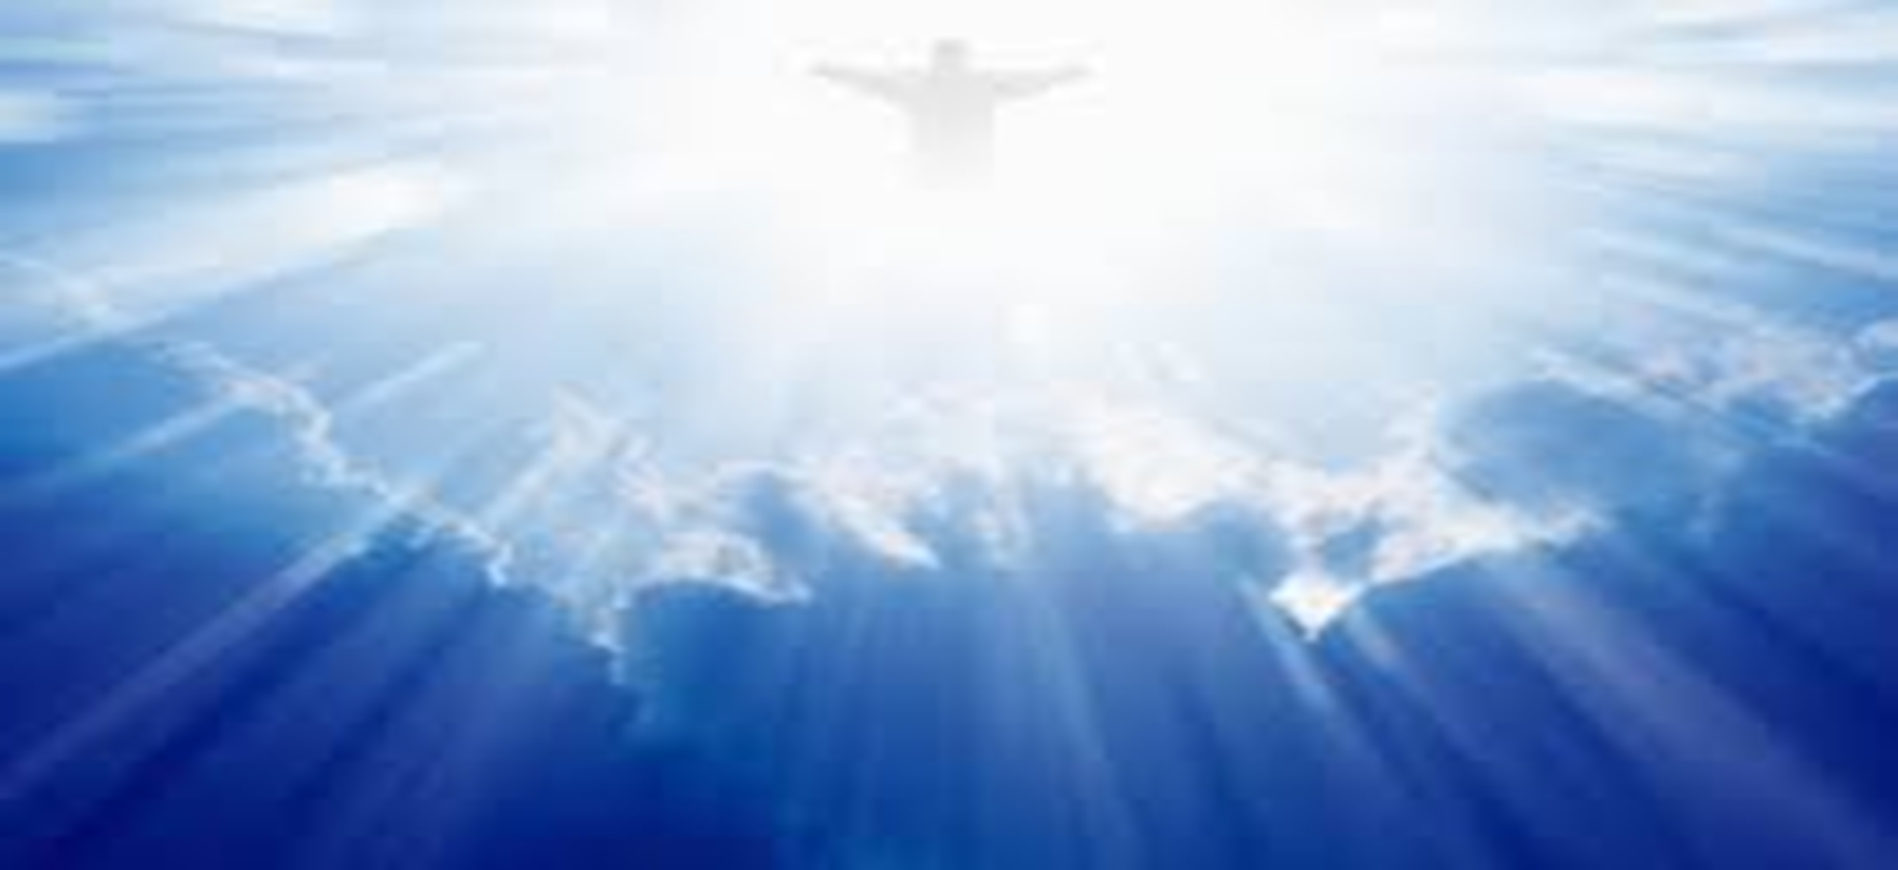
所以 神将他升为至高，又赐给他那超乎万名之上的名，
Wherefore God also hath highly exalted him, and given him a name which is above every name:
叫一切在天上的、地上的和地底下的，因耶稣的名无不屈膝，
That at the name of Jesus every knee should bow, of things in heaven, and things in earth, and things under the earth;
无不口称耶稣基督为主，使荣耀归与父 神。
And that every tongue should confess that Jesus Christ is Lord, to the glory of God the Father.

Slide 11
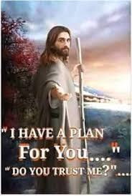
他对您有一个计划，他在等候您的同意。
He has a plan for you and he's waiting for you to say yes.

